Slide 1
Bariatric Surgery Program
eNewsletter | October 2024

Slide 2
A Patient’s Experience After Bariatric Surgery
OCTOBER SUPPORT GROUP
Join a bariatric surgery patient talk about their experience after surgery!
Thursday, October 17th @ 6pm

Slide 3
Aetna patient?
You will receive a link to a survey the day after the Support Group to receive credit for participating. You can also use this link to go to the survey!

Slide 4
Need to register for the
Bariatric Monthly Support Group?
For New and Established Bariatric Patients
Select one or more Support Group Meetings
Click next at bottom of page
Fill in your information
Click next then submit
You will receive a confirmation email with the Zoom link the day before and two the day of the event
Register Here!

Slide 5
Try this tasty pumpkin treat!
Pumpkin Fluff (Sugar-Free + Low Calorie) - Skinny Comfort

Slide 6
Understand more about the body’s hunger signals!
Decoding Satiety: A Functional Nutrition Perspective on Hunger Hormones After Bariatric Surgery : ObesityHelp

Slide 7
Take the Mammogram Pledge - National Breast Cancer Foundation

Slide 8
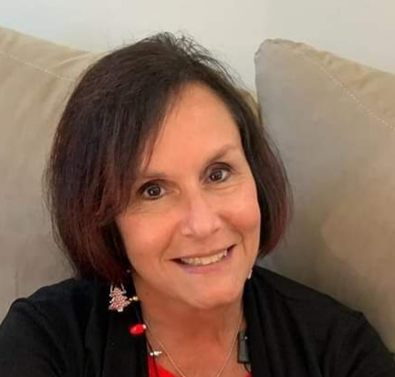
“Hello all! I am retiring as of October 3rd! I have absolutely enjoyed my position in this program. All of you made my job so amazing! I will miss seeing and hearing about your journeys! Please know that you are all fabulous and your determination is inspiring! Please continue to take care of yourselves and I wish you much success, happiness and health!”
Warmest regards,
Sherri Ferry, RN
Bariatric Surgery Program Coordinator

Slide 9
Christiana Care Bariatric Surgery Program
Wilmington Surgical Services
Wilmington Hospital
501 W. 14th Street, Suite 2E15
Wilmington, DE 19801
Are you due for your yearly follow up visit?
Call us today at (302) 320-4175 to make your appointment!
Click here for our Bariatric Surgery Services website!
Click here to join our Facebook page!

