Slide 1
Bariatric Surgery Program
eNewsletter | May 2024

Slide 2
May
Support Group
Ready for some grillin’ & chillin’!!
Cooking Show!
Featuring
Chef Barbara Hanlon,
Registered Dietitian
Cooking up recipes from the Bariatric Cookbook (see below for link)!
Buffalo Chicken Salad with Refried Beans and Salsa, Pg 17-18
Grilled Chicken with Fruit Salsa, pg 115
Grilled Marinated Veggies, Pg 136
Salad tips, BBQ tips (sent in email before event) and ingredient swaps, pg 170
Bonus Dish: Chicken Kabobs
Thursday, May 16th @ 6pm!
Join Here!

Slide 3
Click here to view cookbook!

Slide 4
Aetna patient?
You will receive a link to a survey the day after the Support Group to receive credit for participating. You can also use this link to go to the survey!

Slide 5
Need to register for the
Bariatric Monthly Support Group?
For New and Established Bariatric Patients
Select one or more Support Group Meetings
Click next at bottom of page
Fill in your information
Click next then submit
You will receive a confirmation email with the Zoom link the day before and two the day of the event
Register Here!

Slide 6
You are not alone!
Reach out for support provided by the National Alliance for Mental Illness (NAMI).
NAMI HelpLine | NAMI: National Alliance on Mental Illness
1-800-950-NAMI

Slide 7
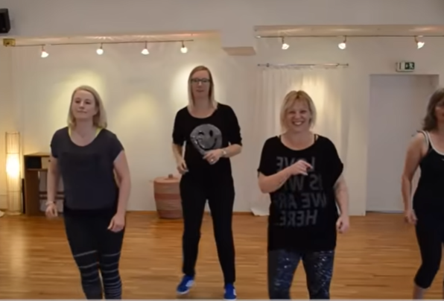
Feel like a “Dancing Queen” with this fun exercise!
WE LOVE DANCE The 80s Dance-Party - Full Version (35 Min.) (youtube.com)

Slide 8
Need a healthy side dish to bring to a Memorial Day Celebration?
Try this tasty recipe!
3-Ingredient Avocado Deviled Eggs Recipe : ObesityHelp

Slide 9
Christiana Care Bariatric Surgery Program
Wilmington Surgical Services
Wilmington Hospital
501 W. 14th Street, Suite 2E15
Wilmington, DE 19801
Are you due for your yearly follow up visit?
Call us today at (302) 320-4175 to make your appointment!
Click here for our Bariatric Surgery Services website!
Click here to join our Facebook page!

