Slide 1

Bariatric Surgery Program
eNewsletter | July 2024

Slide 2


Support Group
Bariatric Surgery Patient
Join
Bariatric Surgery Patients for an open discussion!
Hear their experiences and ask questions!
Thursday, July 18, 2024
@ 6pm
S
“We make sure we are all okay. If you struggle, we are here for you!”
“Find a good mirror, take every picture. Trust me, when you look back, you’re going to see how much progress you’ve made!”
“There will be road bumps. Keep pushing forward and lean on your support system!”

Slide 3
Aetna patient?
You will receive a link to a survey the day after the Support Group to receive credit for participating. You can also use this link to go to the survey!

Slide 4

Need to register for the
Bariatric Monthly Support Group?
For New and Established Bariatric Patients
Select one or more Support Group Meetings
Click next at bottom of page
Fill in your information
Click next then submit
You will receive a confirmation email with the Zoom link the day before and two the day of the event
Register Here!

Slide 5



Try this recipe for your July 4th BBQ Celebration!
Steph Wagner’s Grilled Sour Cream and Onion Burgers: Obesity Help!

Slide 6

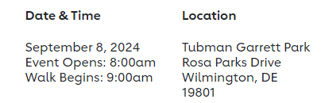

You Are Invited to the Wilmington Heart Walk
Join our team or donate! Click here: TeamLosetoWin
Join Dr. Halbert, our coach, and our team and patients for this fun event!

Slide 7
Are you about 2 months after surgery?
Join these virtual group sessions held the 1st Monday of each month!
Discuss common issues early after bariatric surgery
Review motivational and psychological strategies to help start and sustain changes
Identify warning signs of getting off track
Review when you should ask for help
Get support from others
And much more!
Call the
Weight Management Center Schedulers
@ 302-623-3475, Option 2!
NEW!
Post Surgery Psychology Group Sessions

Slide 8
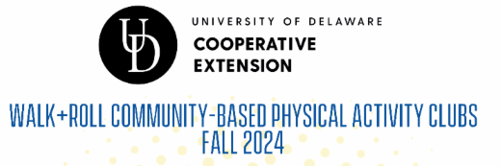
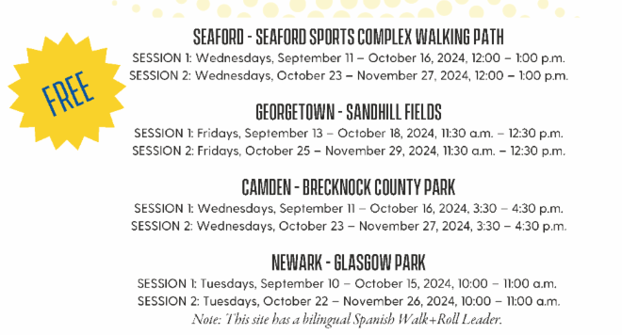
Register HERE

Slide 9

Christiana Care Bariatric Surgery Program
Wilmington Surgical Services
Wilmington Hospital
501 W. 14th Street, Suite 2E15
Wilmington, DE 19801
Are you due for your yearly follow up visit?
Call us today at (302) 320-4175 to make your appointment!
Click here for our Bariatric Surgery Services website!
Click here to join our Facebook page!

